Slide 1

Nextcloud as Identity Provider? SCIM Client Integration for Multi-Platform Collaboration
Dr. Edward Ly, Software Engineer @ Nextcloud GmbH
FOSDEM 2026, 1 February 2026
Notes:
Thank you all so much for coming.
I’m sure you’ve read the title by now and you’re probably curious about what this project is all about.
Perhaps you might be thinking what the purpose of this app is or what you can do with it.
But first, a quick introduction.
For those of you who don’t know me, my name is Edward Ly and I am currently a software engineer at Nextcloud and a member of the integrations and AI team.
The project I will show you today is one of many projects under our team’s umbrella that aim to make it easier to communicate and collaborate with external services, rather than have Nextcloud just exist in its own isolated environment.
So by the end of this talk, you will know what the app can do and what it looks like in practice.

Slide 2

What is Nextcloud?
More than just file sharing
Video conferencing
Office suite
Groupware (email, calendar, contacts)
AI assistant/agent
(and more!)
500+ apps in the app store (apps.nextcloud.com)
400,000+ instances, millions of users
Notes:
In case you’re not familiar with Nextcloud, I will give a very brief introduction.
The simplest way I can explain what we do is that we are the biggest free software alternative to big tech’s cloud offerings such as Google Workspace, Microsoft 365, Dropbox, Slack, Zoom, and many others.
Especially in recent years, Nextcloud is exploding in popularity among not just home users, but also major organizations in both the public and private sectors, with hundreds of thousands of Nextcloud server instances online serving millions of users worldwide.
And those numbers only include the ones that we know about!
Recently, we have been pushing forward into the AI space as well with what we call our “Nextcloud Assistant” to keep up with demand and feature parity, but I want to be very clear that all of these additional apps are optional by default, and you can even pick and choose which specific features you want to enable or disable for your Nextcloud server.
But the reason we have all of these apps in the first place is that there is a ton of convenience in using an all-in-one collaborative suite, because I simply cannot stress enough the value of having all these apps and features integrated into one cohesive ecosystem which makes everyday tasks super convenient and more productive, all without sacrificing data privacy or security.
And the app I’ll demonstrate today is only one of many examples of this.

Slide 3

Notes:
But first, a little bit of background.
This project first started about a year ago when we received an interesting request from OpenProject, which in case you haven’t heard is an open-source project management software that rivals proprietary alternatives such as Jira, Trello, or Monday.com.
We’ve worked together with OpenProject for quite a while now and have developed a few apps that integrate tightly each other, but this time, they had a new avenue that they wanted to explore further.
Basically, can we use the user credentials in Nextcloud to login to OpenProject, and can we simplify the process of managing user accounts across both services?
This makes it a lot easier for users within a group or organization to not have to juggle multiple passwords, as well as for administrators to not have to manually create the same set of users across multiple services.

Slide 4
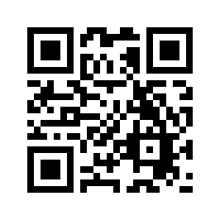
About SCIM
System for Cross-domain Identity Management
  Standard for automated identity information exchange
  A user service can be a SCIM client or SCIM server
  SCIM clients send updated user/group records to SCIM servers
    In Nextcloud, as regular background jobs
  Standardized REST API
  RFCs 7642-7644: https://tools.ietf.org/wg/scim/
  Identity and Access Management
Notes:
And that is where the SCIM standard comes in.
In case you’re not aware, it is short for System for Cross-domain Identity Management.
This standard automates the exchange of user identity information across different external services.
This standard has also been adopted by companies including Microsoft, Google, and Salesforce.
So in theory, you might be able to provision Nextcloud users in not just OpenProject, but also Google Workspace and similar services as well.
But let’s not get too ahead of ourselves.
To briefly explain how it works under the hood: first, you need to designate each service as either a SCIM client or a SCIM server.
The SCIM clients act as the identity provider which send their user and group records to SCIM servers.
For instance, in our case, Nextcloud would act as the client and OpenProject would act as the server.
And once the clients and servers are configured, that is it; the rest is entirely automatic.
With the Nextcloud client app, it will continuously run background jobs that communicate to the servers using a standardized REST API defined by SCIM.
The first background job will send all Nextcloud user and group records to the OpenProject server and make sure that the information is up to date.
And then, the second job onwards will only send any changes that have occurred between the current background job and the last.
Say, whenever a client’s identity records are updated, added, or deleted, we send those changes via an API request to the servers that we wanna sync up to.
At first, it may sound like a very simple task, but if you have ever managed your own cloud services with hundreds, thousands, possibly millions of users, you’ll quickly realize how much time you’re saving by having to only manage users in one service rather than multiple.
If you’re interested in learning more about the standard itself, I’ve left the link and QR code to the RFCs here which you can read on your own.
Although, perhaps you might have noticed that the SCIM standard only takes care of the identity management part for you.
It does not handle access management or implement some kind of authorization provider that lets users created in Nextcloud to actually login to OpenProject.
That is handled by other open standards such as OpenID Connect or SAML.
That does mean you will need a separate app that offers one of those authorization mechanisms, but really, that is the only dependency we need to get a server-client connection up and running.

Slide 5
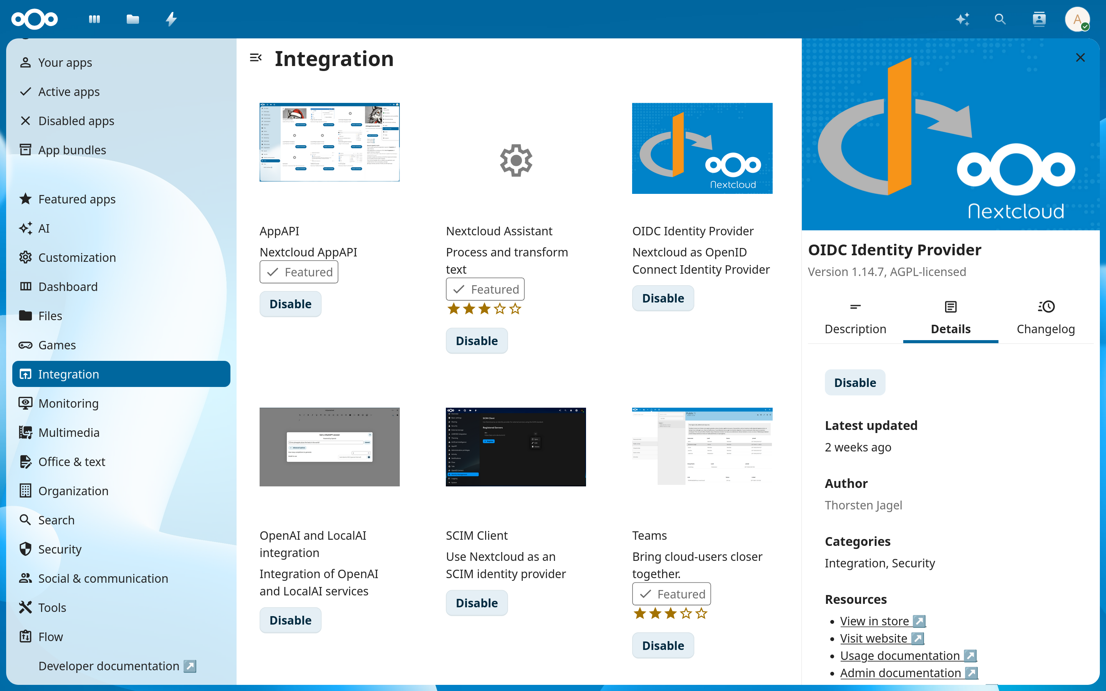
Notes:
So let’s take a look at how it all works together and see it in action.
For this demo, I’ll be doing a brief walkthrough of how to configure both Nextcloud and OpenProject so that they share the same identity records.
Here, we’ll be using OpenID Connect via the OIDC app as our authorization provider.
And I have already setup a few local Docker containers ahead of time running Nextcloud and OpenProject with their own local domain names.
So the first thing we need to do is to install both the OIDC app and the SCIM client app in Nextcloud.
You can find them from the apps page in the Nextcloud server and download them directly from there under the integrations category.
This is what the OIDC app looks like in the app page.

Slide 6
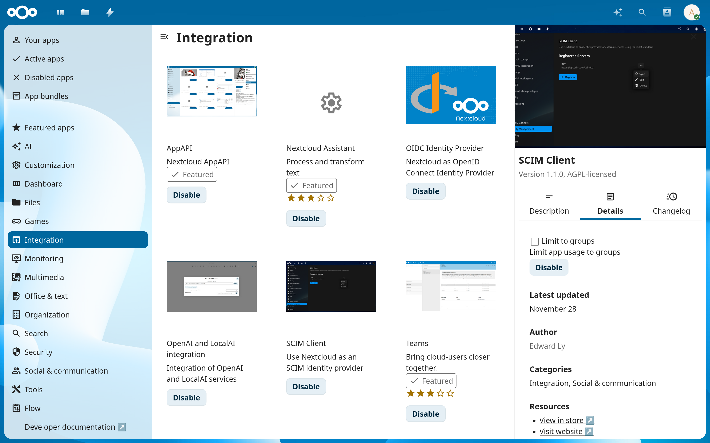
Notes:
And similarly for the SCIM app.
By the way, like most apps in the Nextcloud ecosystem, it is licensed under the AGPL v3 which is, really, the only sensible option for software such as this.

Slide 7
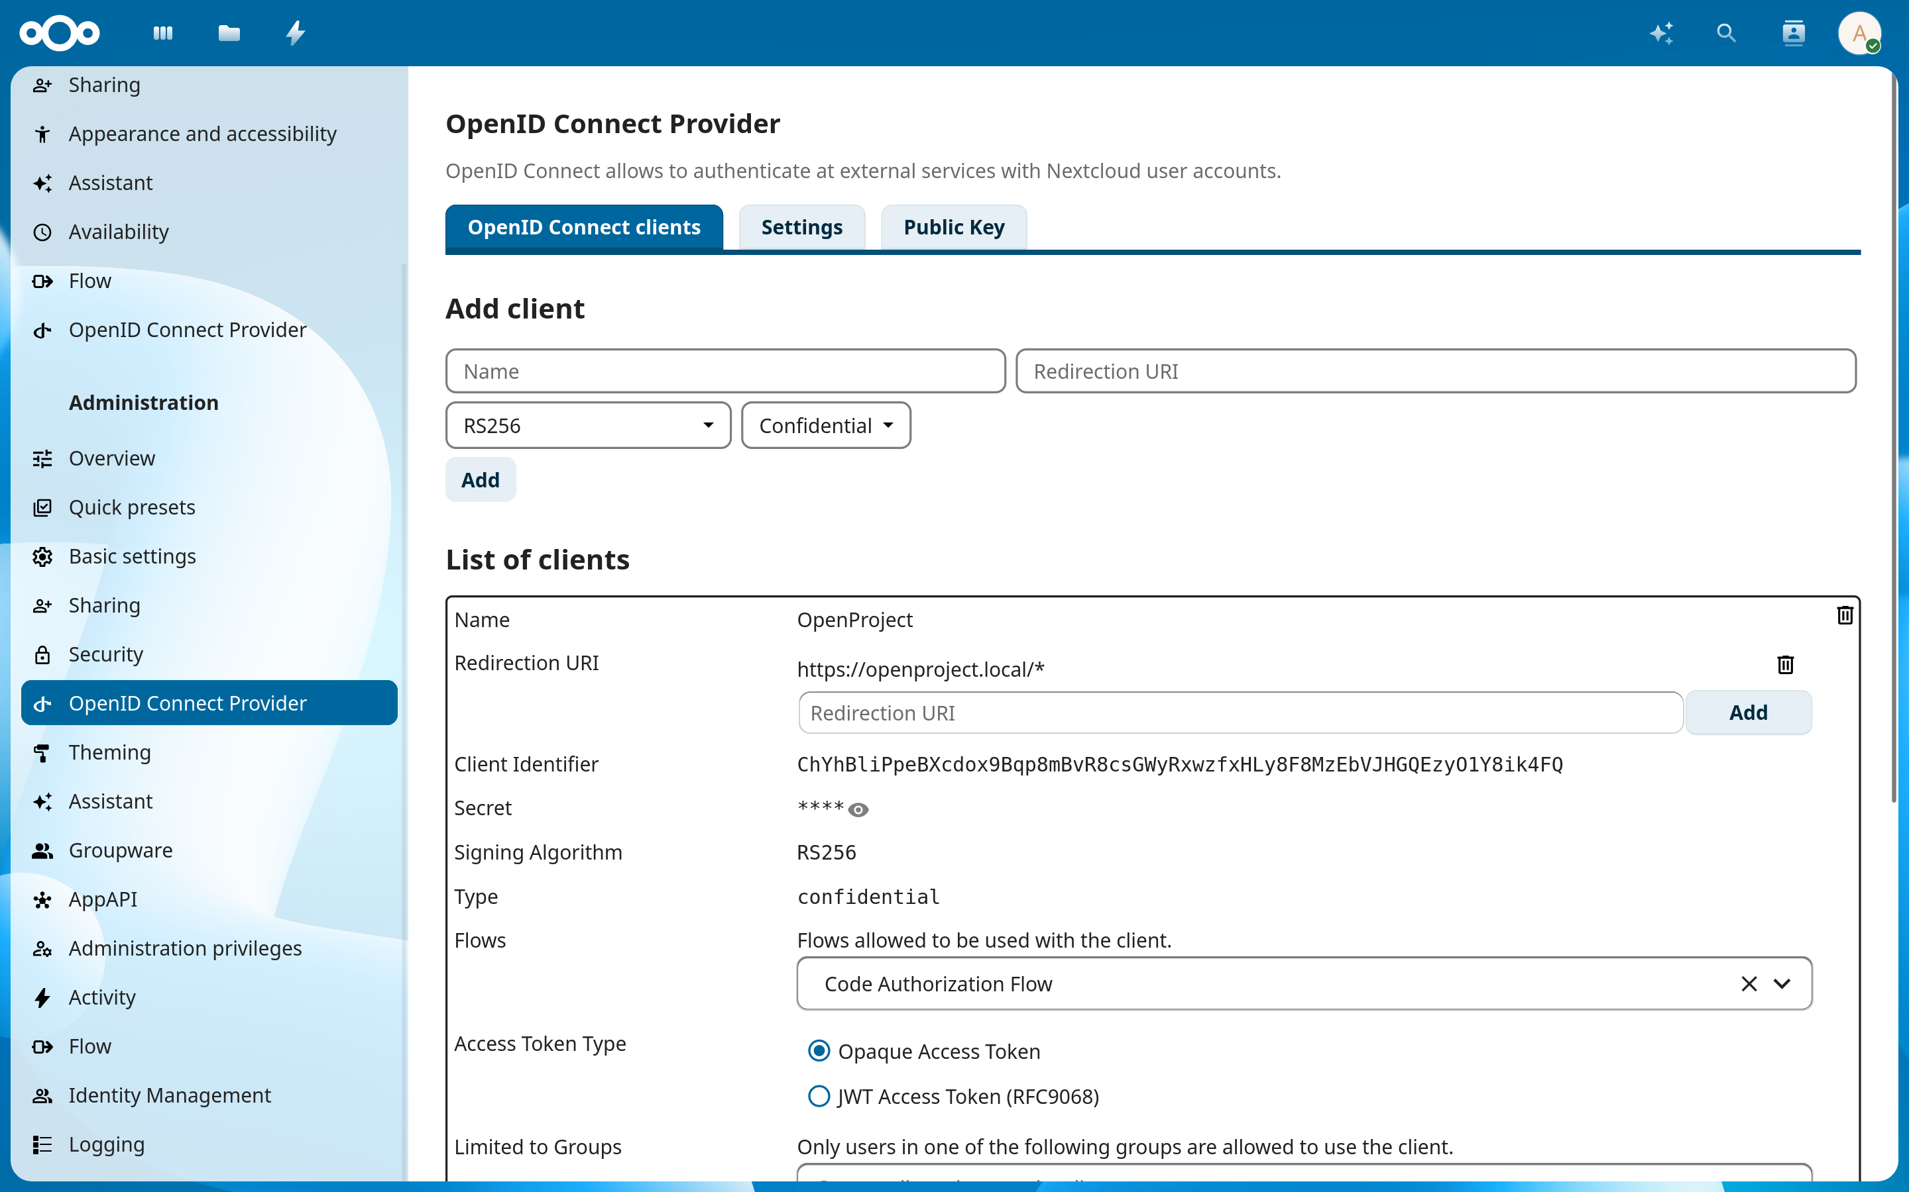
Notes:
Anyway, next, we need to create a new OpenID Connect client.
This will be our authorization provider that Nextcloud users will use to login to OpenProject.
In the administration settings, there will be a section called “OpenID Connect Provider” which takes us to this page.
For a minimal setup, all you really need to do is enter a nickname for the client and the redirection URI.
For simplicity, we can just set the URI to match all pages within the openproject.local domain.
Once it’s created, it will generate a client ID and a client secret value which we’ll need in the next step.

Slide 8
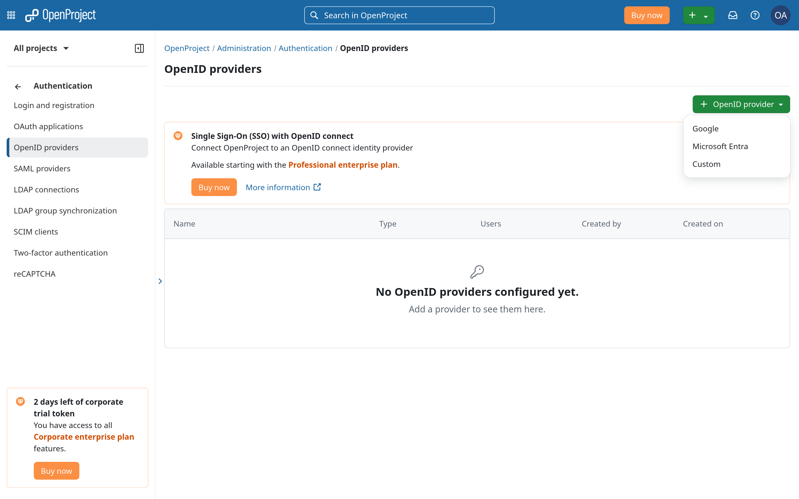
Notes:
From here, we can now head over to our OpenProject instance and connect our OIDC client we just created to OpenProject.
We’ll create a new custom OpenID provider here...

Slide 9
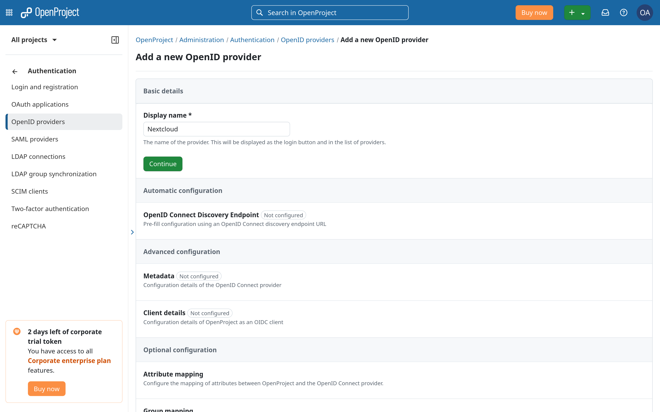
Notes:
...which takes us to the setup wizard.
There are really only a few things we need to enter here: first, a nickname for the provider.

Slide 10
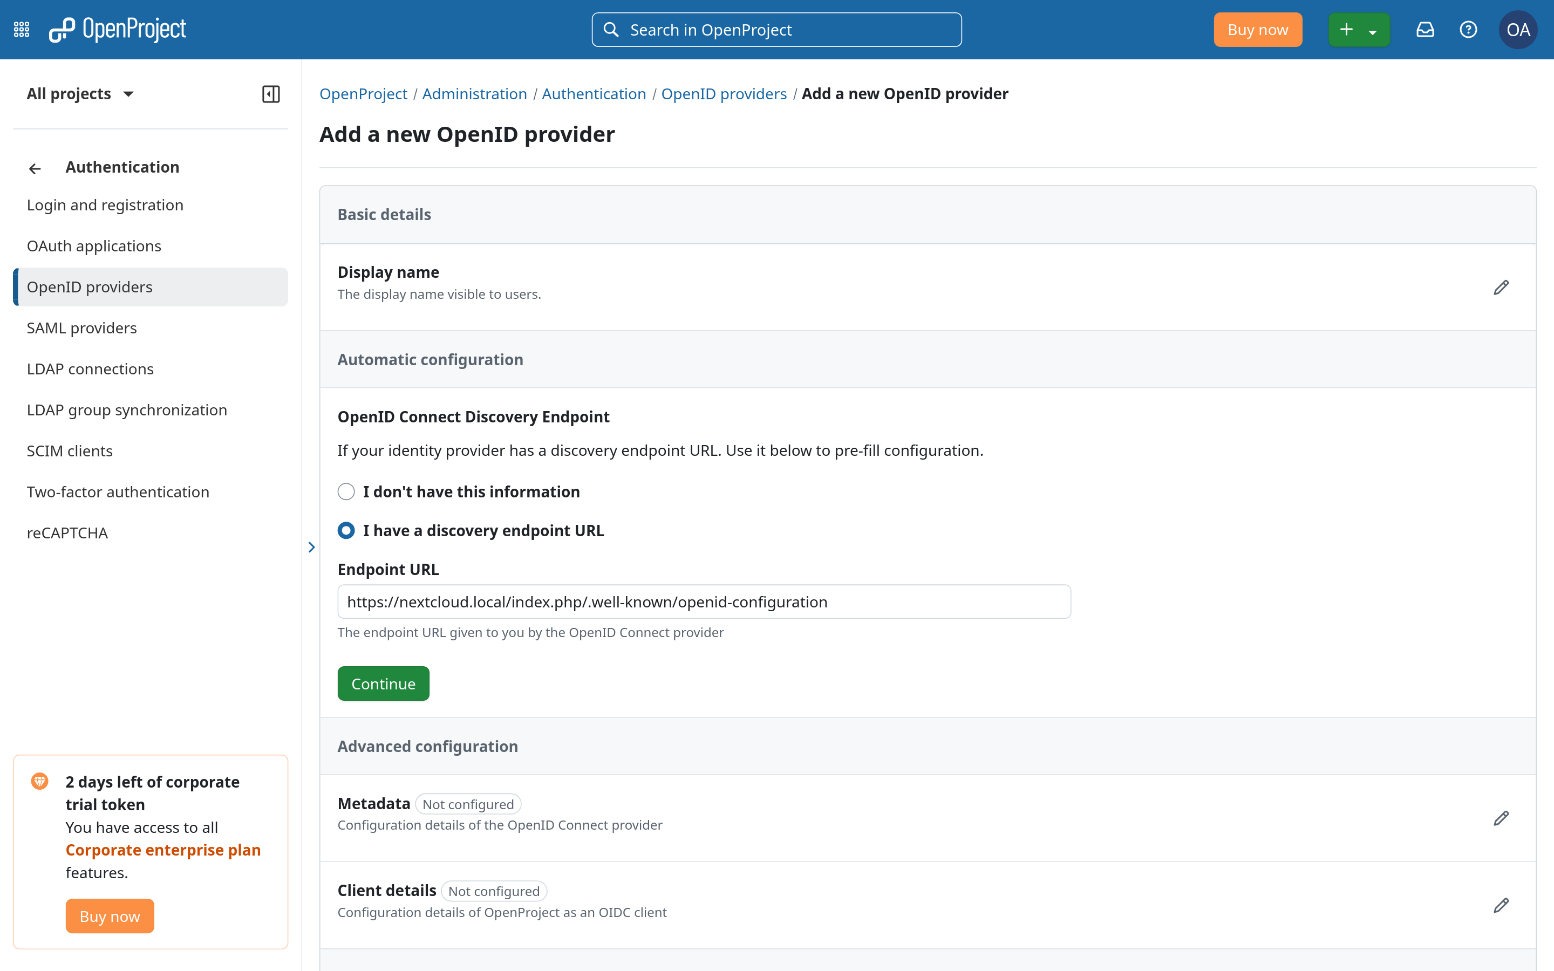
Notes:
Second, the discovery endpoint URL, which in most cases should be the well-known configuration endpoint.

Slide 11
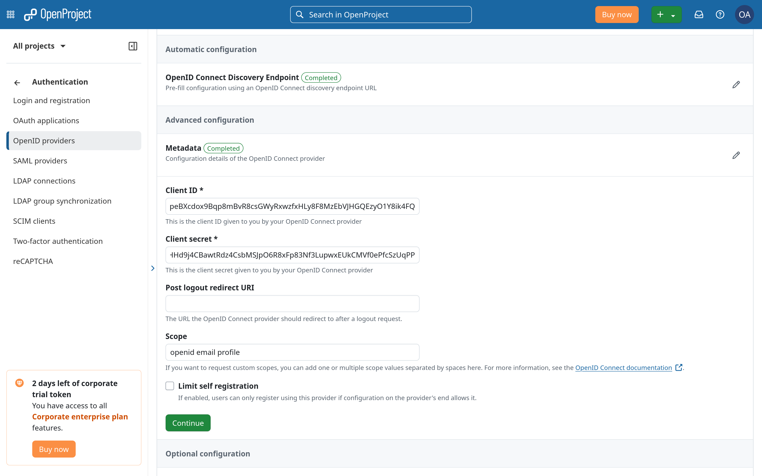
Notes:
And third, the client ID and client secret values, like I mentioned.
For this demo, it’s fine to leave everything else by default, but of course, they can be adjusted depending on your specific needs.

Slide 12
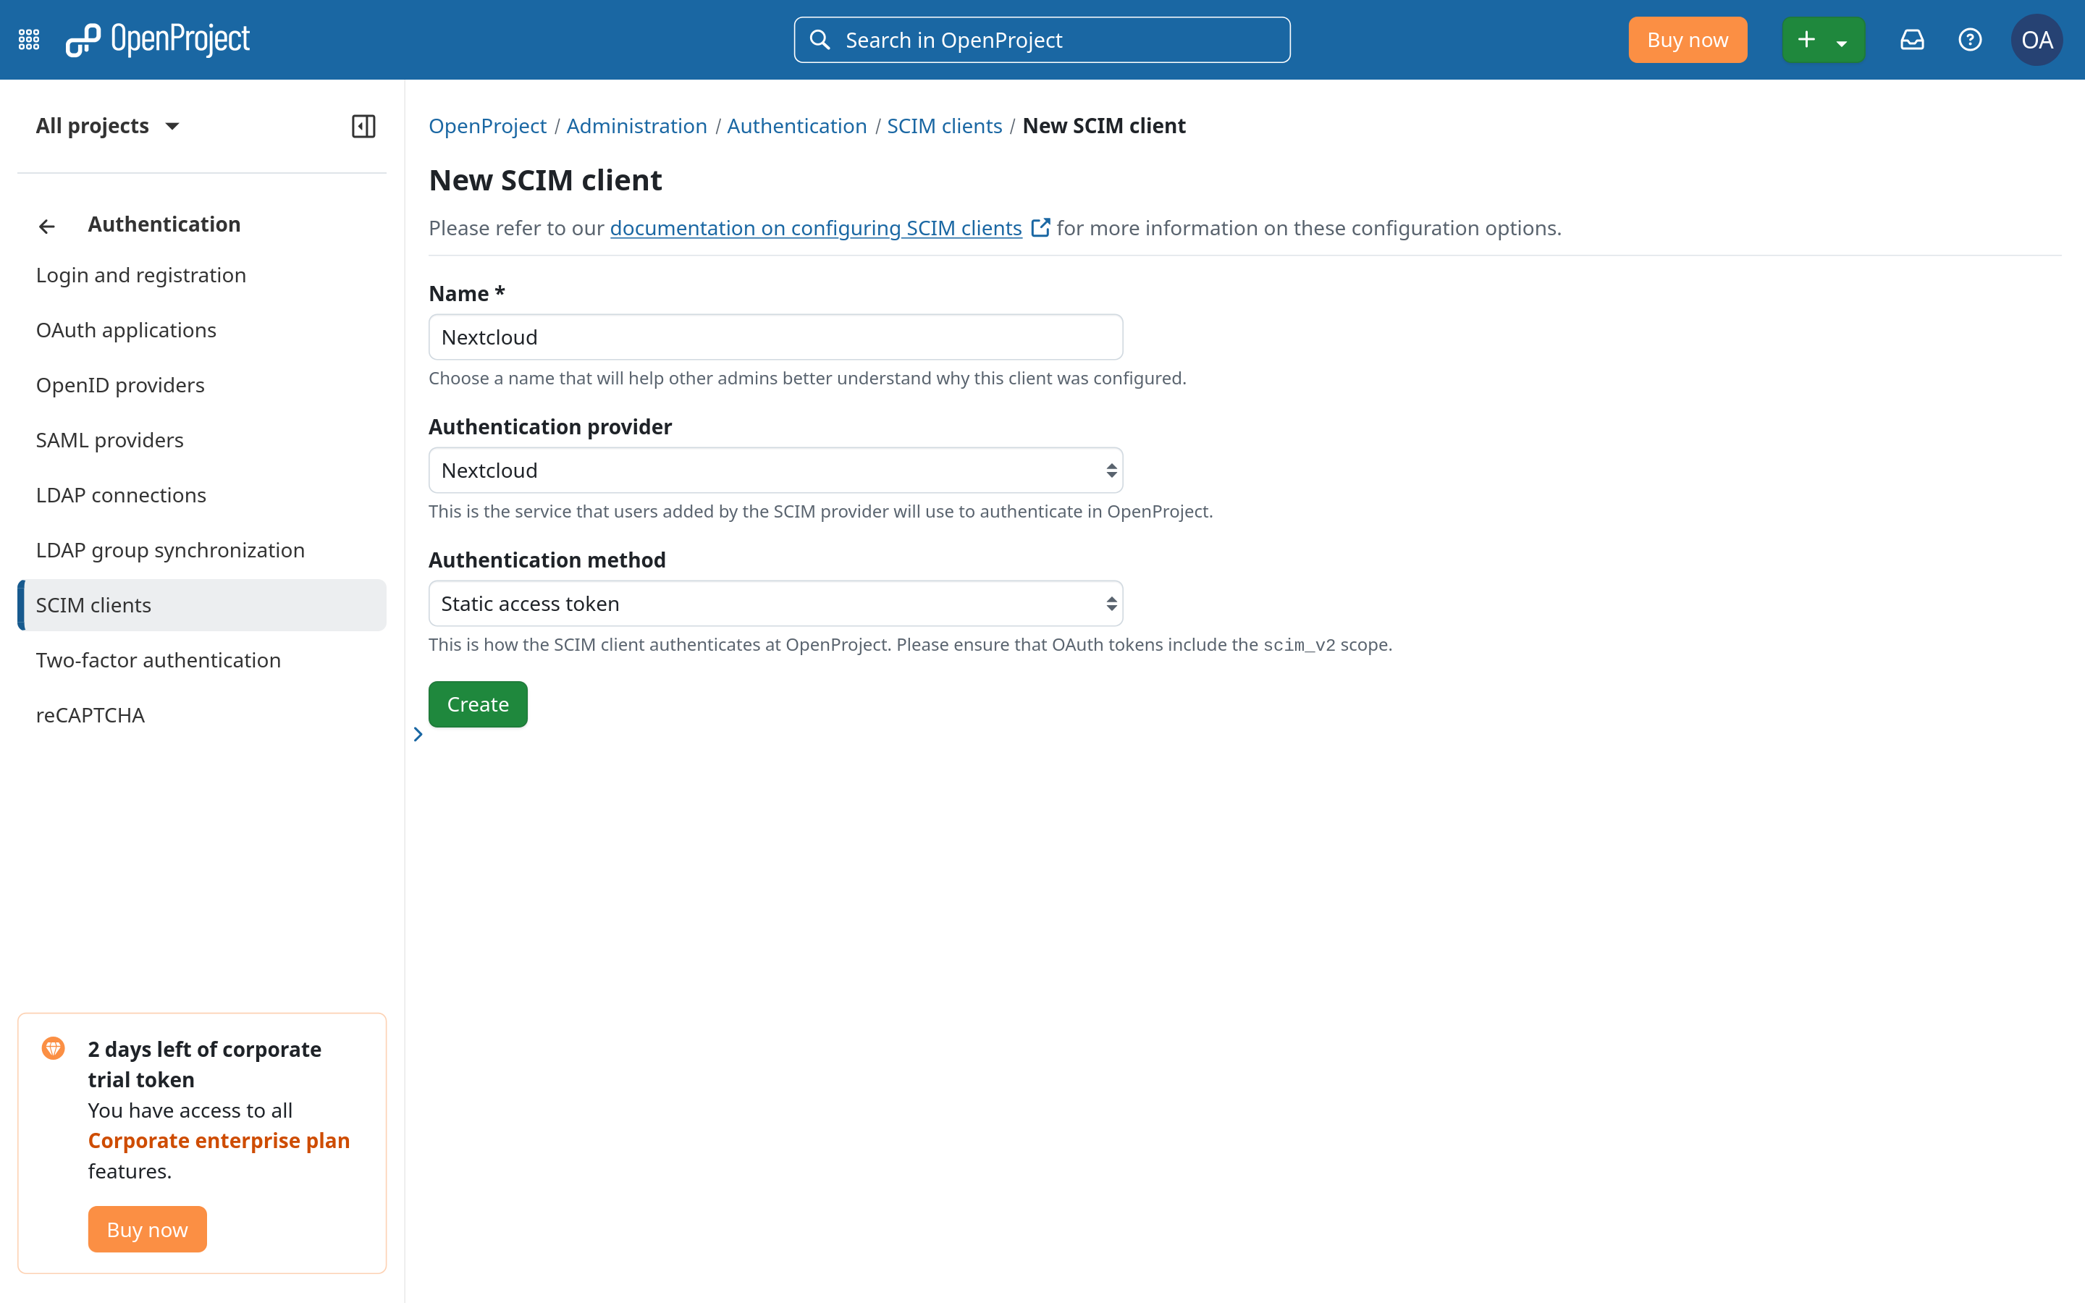
Notes:
After that, we can now configure a new SCIM client that is authorized to sync to OpenProject.
Here, along with giving a nickname for the client, you can also choose the authentication provider at this step, which tells OpenProject that any users added to OpenProject from this SCIM client has to login through this specific authentication provider.
We’ll also generate a static bearer token that the Nextcloud SCIM client will use to authenticate to the OpenProject server in order to send API requests.
Once you click on “Create”, you’ll be able to view and copy the bearer token which we will paste into the Nextcloud client.

Slide 13
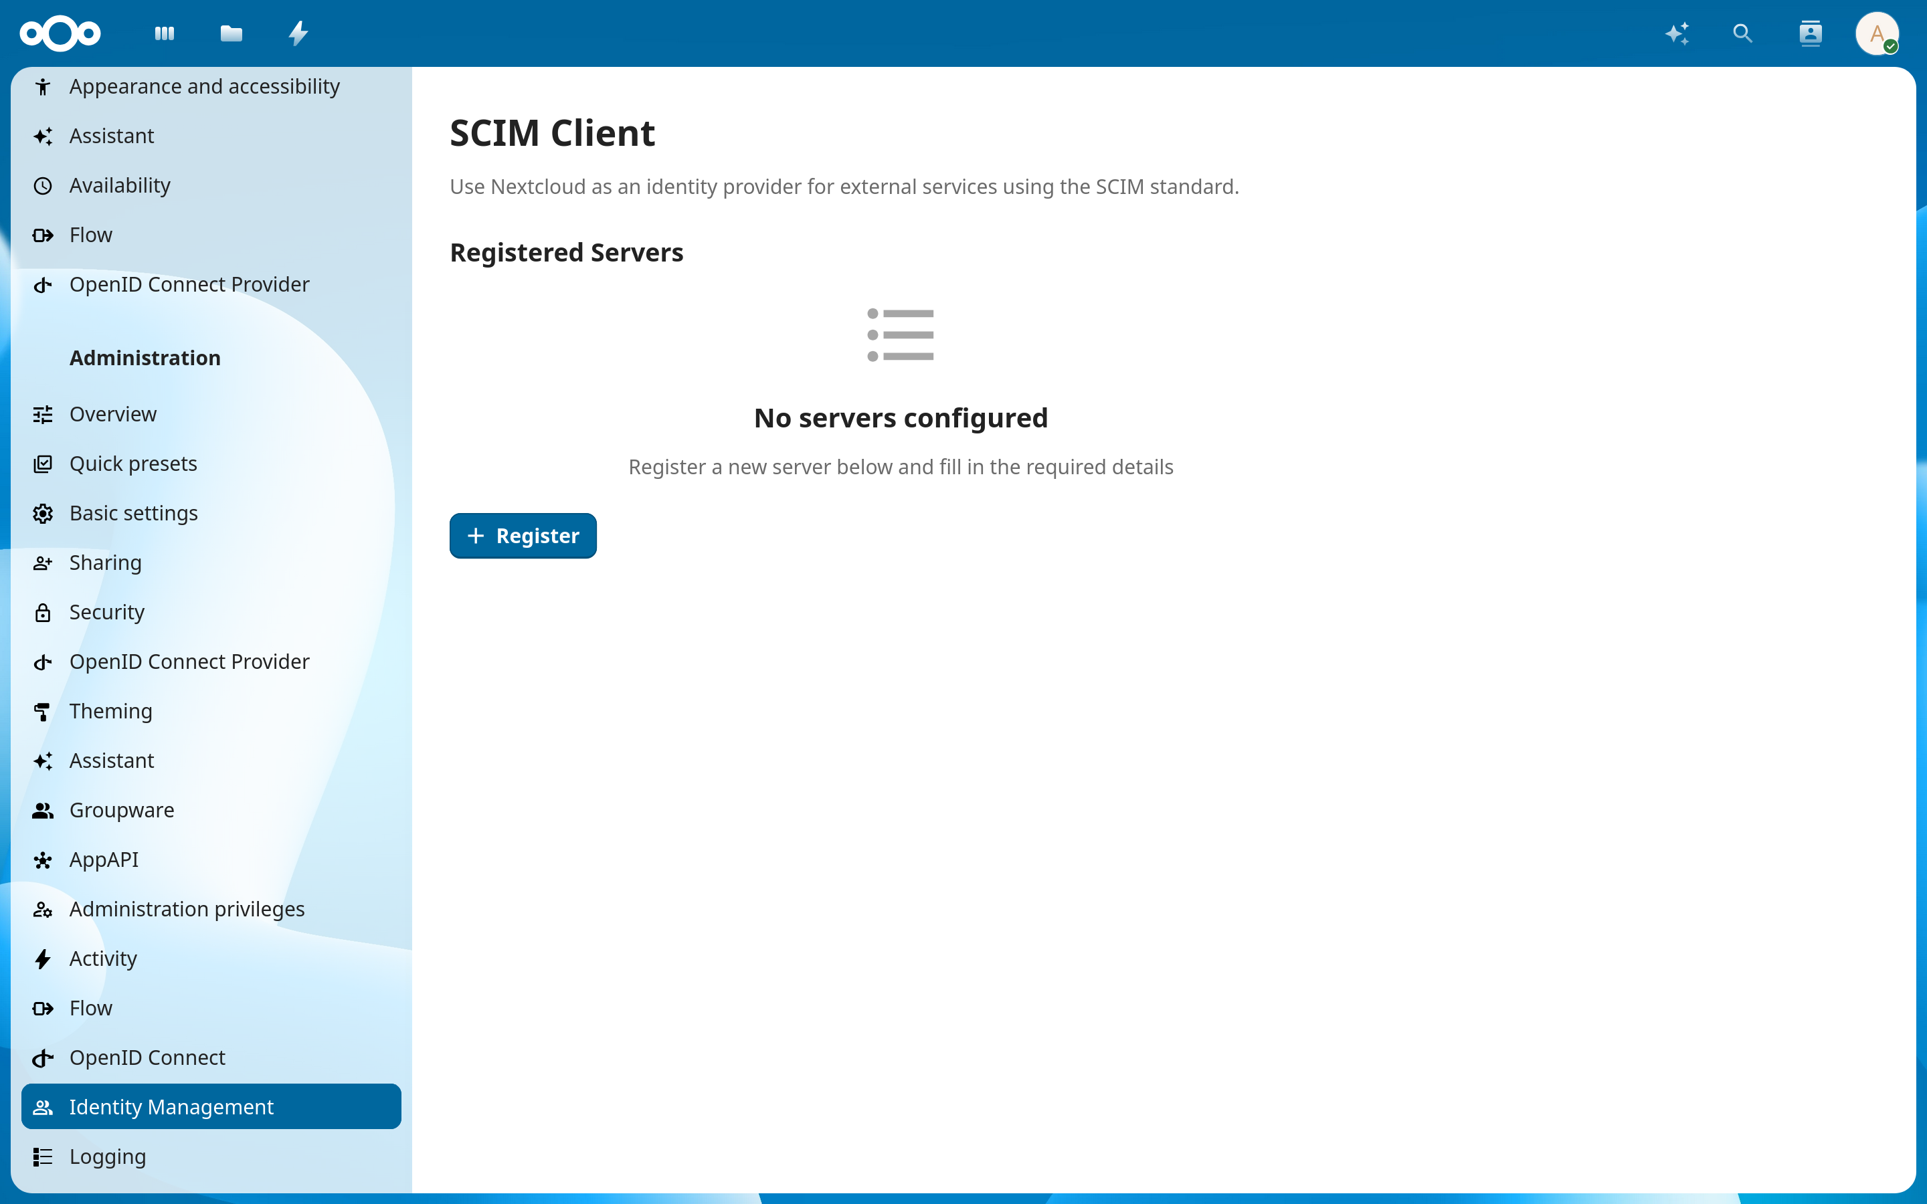
Notes:
So back to Nextcloud, we can access the SCIM client app from the administration settings under the “Identity Management” section.
Here is where we can actually register OpenProject as a SCIM server.

Slide 14
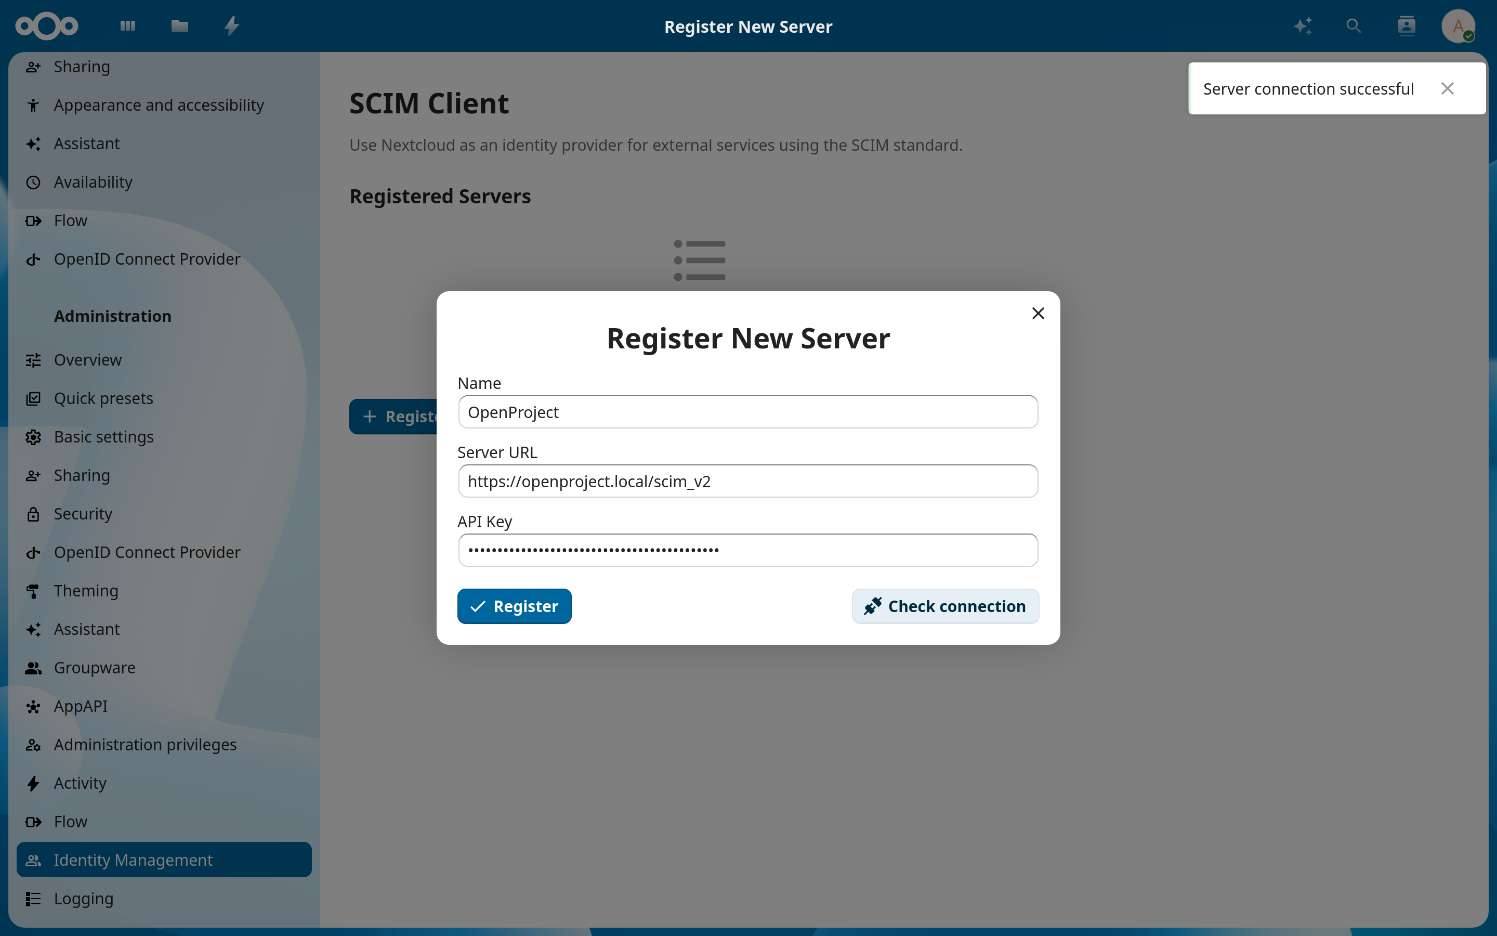
Notes:
Clicking on the “Register” button opens up a short form which only requires a few pieces of information: a nickname for the server, the root URL of the SCIM server API, and the bearer token that we received in the previous step.
At this point, you also have the option to verify that the information is correct and the client can actually connect to the server, but that is entirely optional.

Slide 15
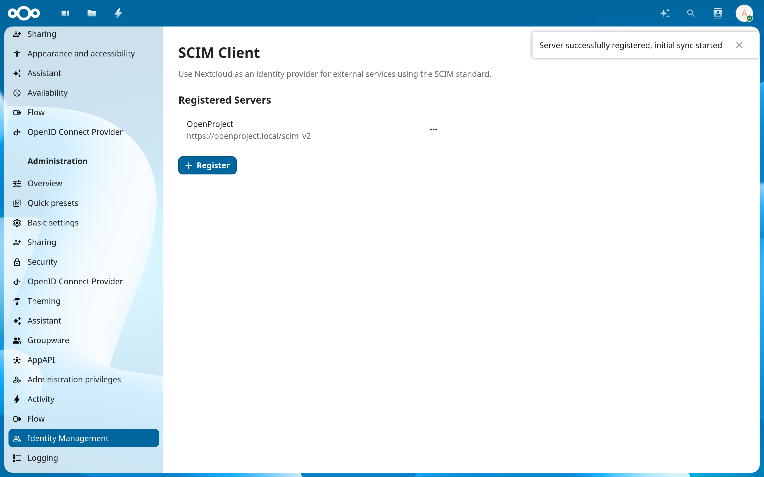
Notes:
Once everything is filled in, submit the form and now we have the OpenProject server attached to the Nextcloud client.
And that pretty much concludes the end of the configuration procedure,
That is it in terms of user input.
From there, Nextcloud will automatically run background jobs every few minutes that will send its identity records to OpenProject, where users will be provisioned or updated accordingly.

Slide 16
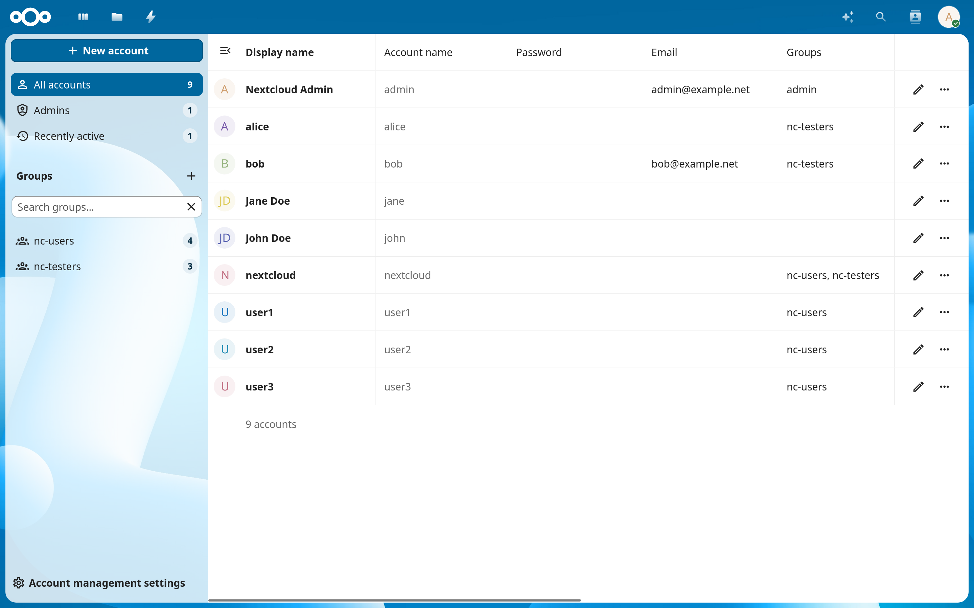
Notes:
And to verify that our setup actually works, let’s take a look at what actually happens to our users on both services.
So here is a sample of test users that I have created in this Nextcloud development instance.
Some of them have email addresses already assigned, some of them have a full name specified that is distinct from their username, and some of them may be a member of one or more groups.

Slide 17
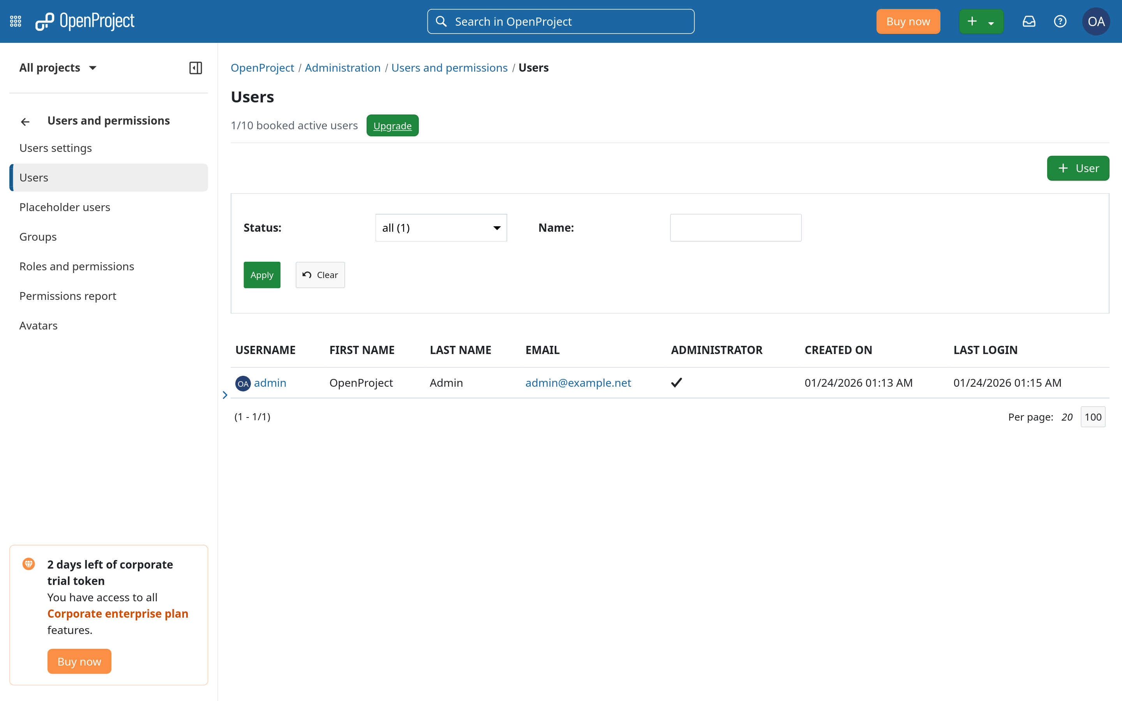
Notes:
Now, if we head over to OpenProject, this is what the list of users looks like before the initial sync happens.
You can see we have just the one root user that is needed to manage the instance.

Slide 18
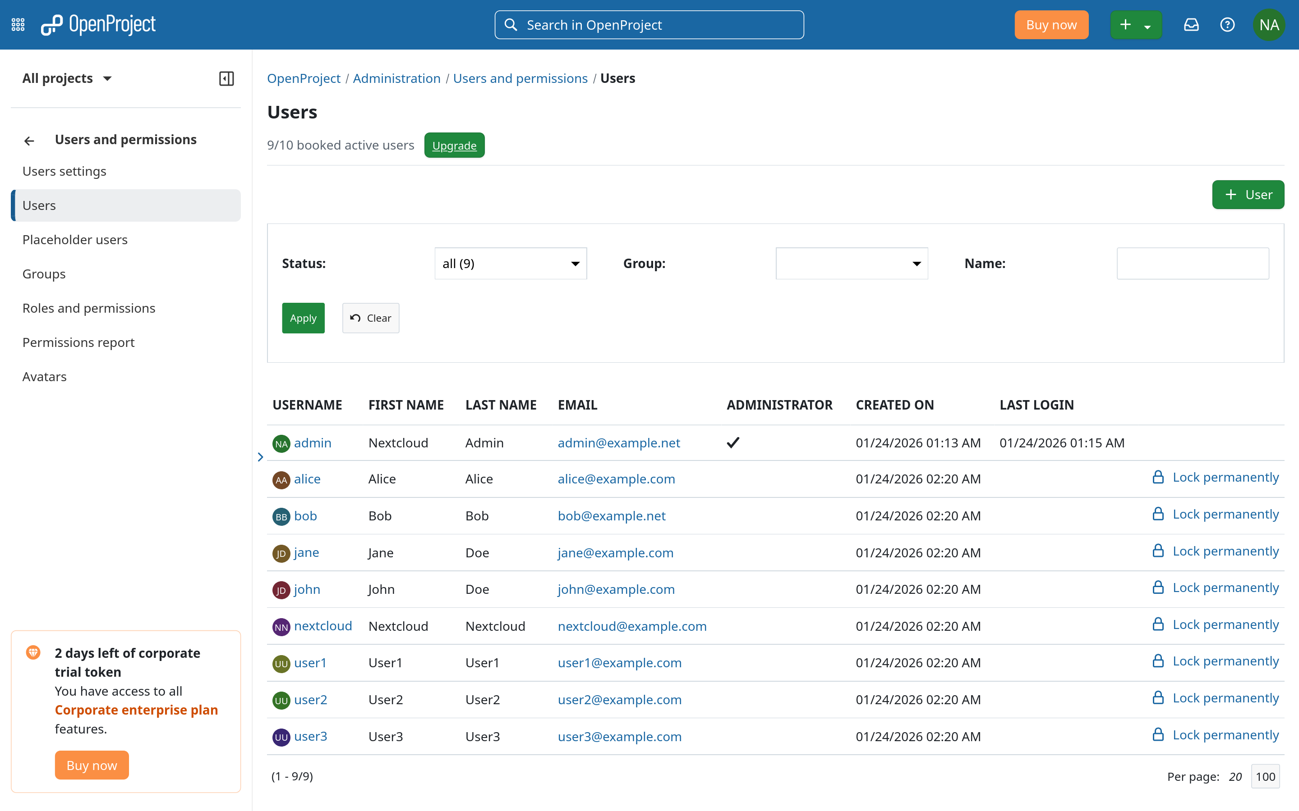
Notes:
And here is what it looks like after the sync.
Since email addresses are optional in Nextcloud but required in OpenProject, you can see that some of the users also have temporary email addresses assigned to them if they didn’t have one assigned in Nextcloud.

Slide 19
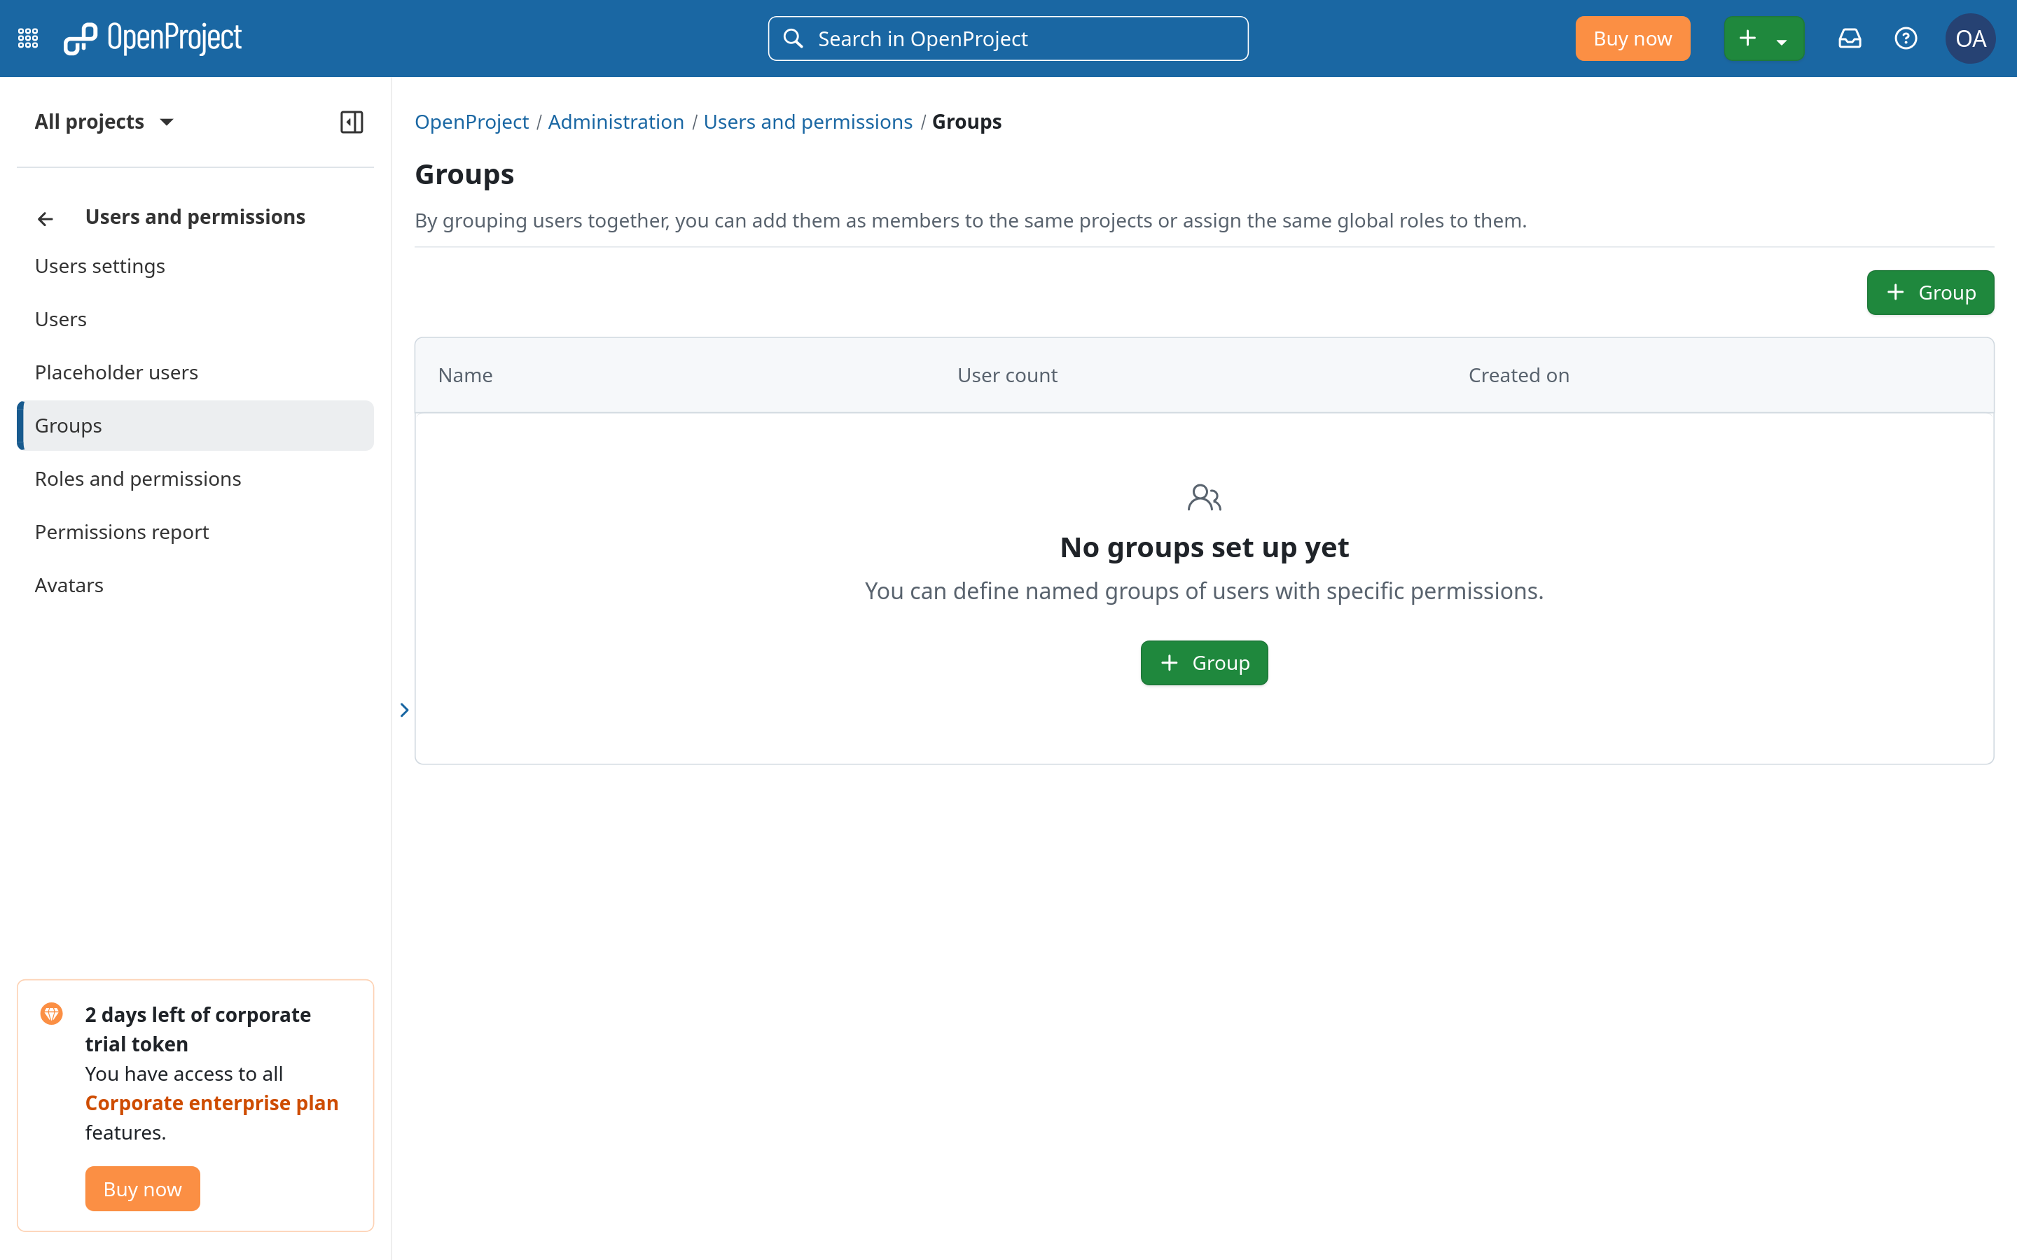
Notes:
As for user groups, similar deal.
Initially, OpenProject doesn’t create any groups by default.

Slide 20
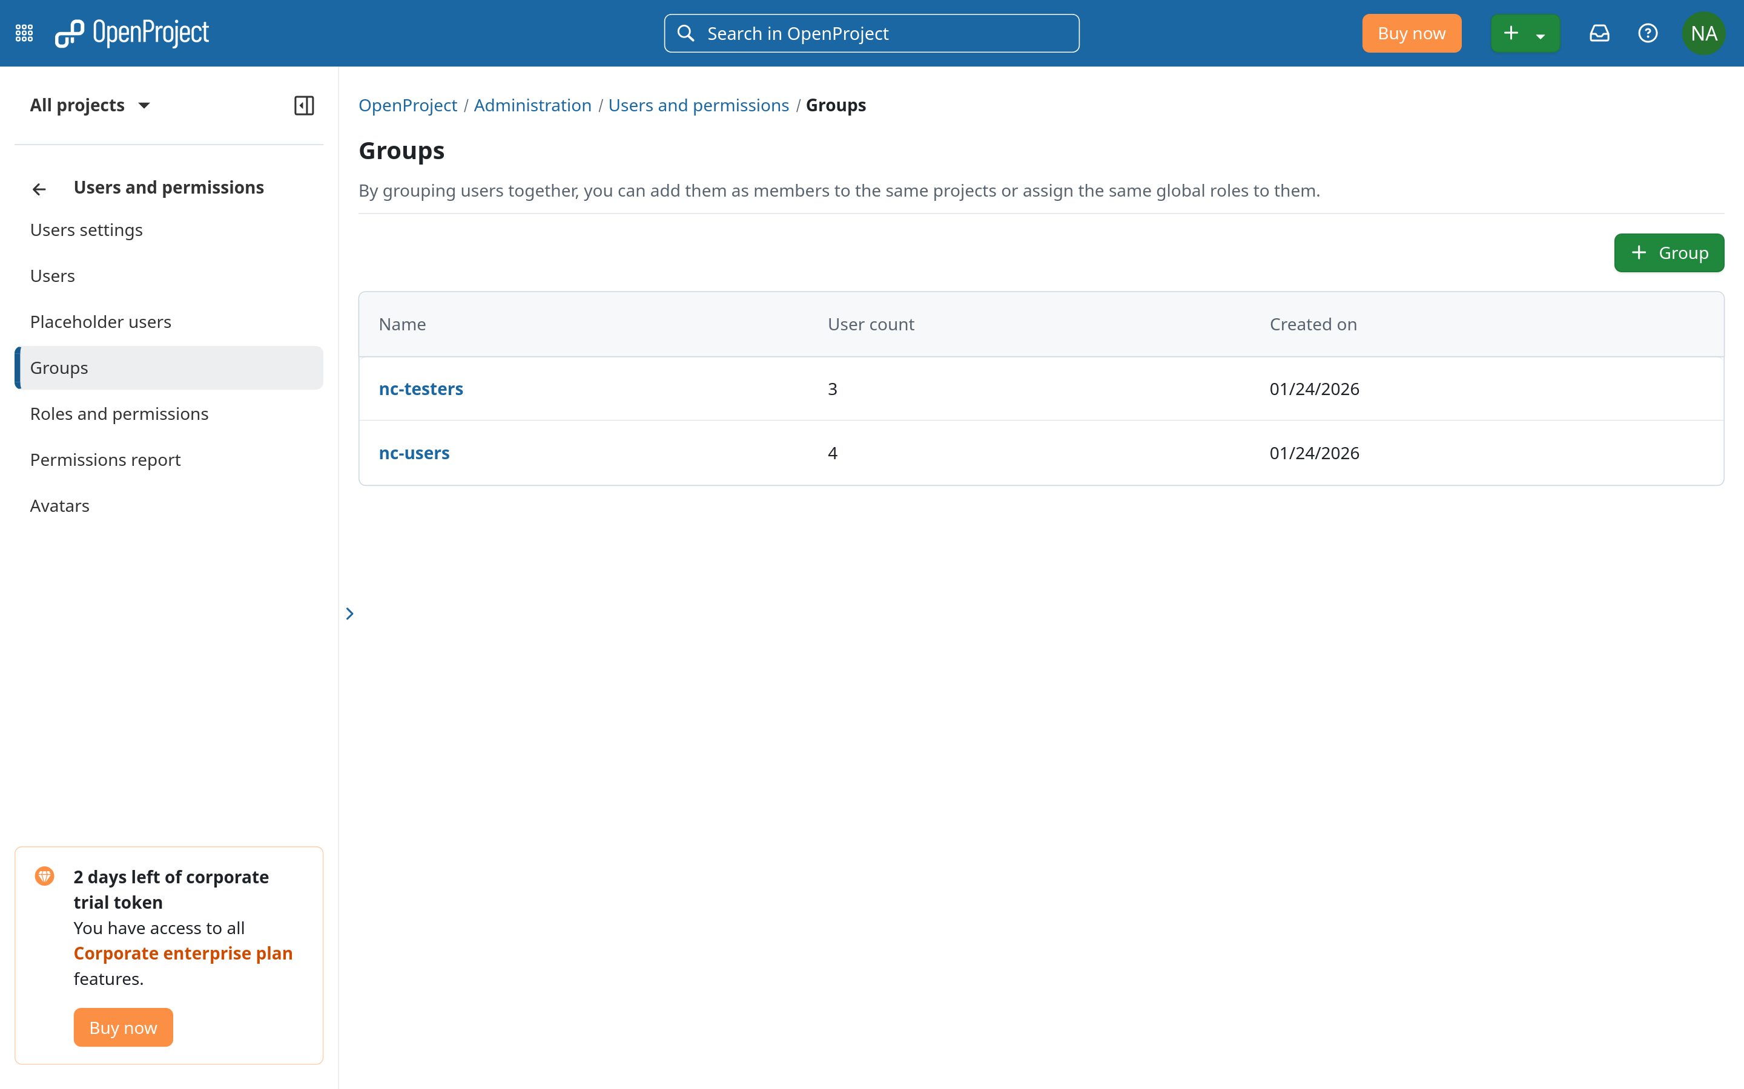
Notes:
But after syncing, as you can see, the users group in Nextcloud have successfully transferred over as well.

Slide 21
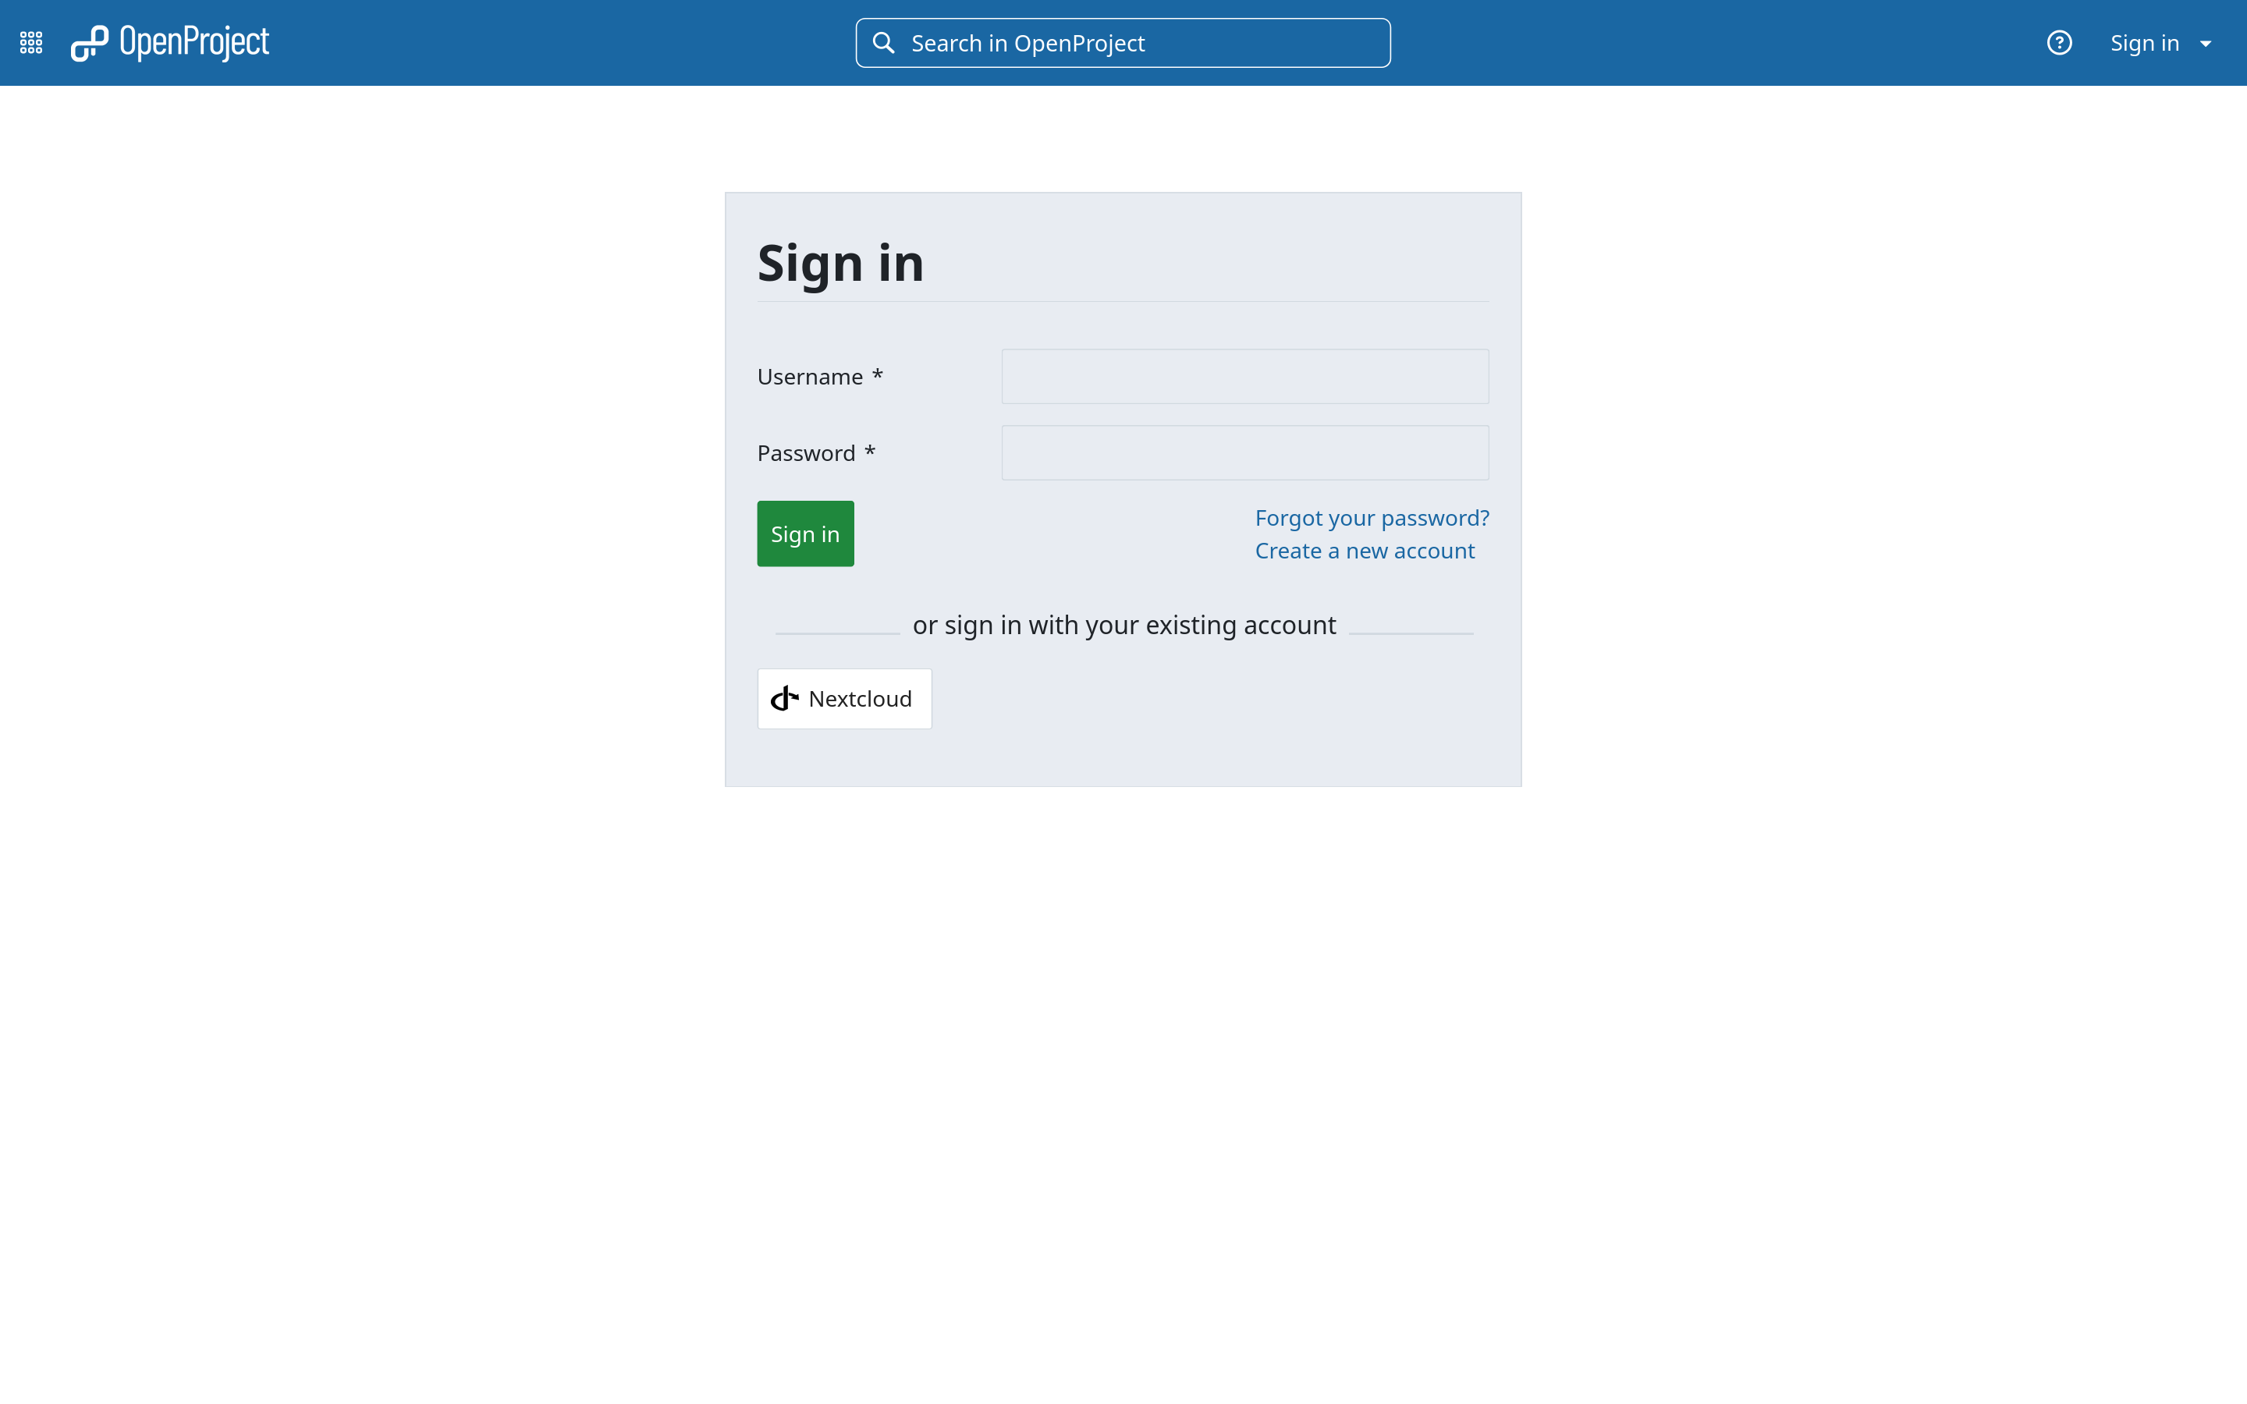
Notes:
Now, the last thing we need to verify is that the users we created in OpenProject can actually login using their Nextcloud credentials.
So back in the login screen for OpenProject, you can see that there is an option now to sign in via our Nextcloud local instance.

Slide 22
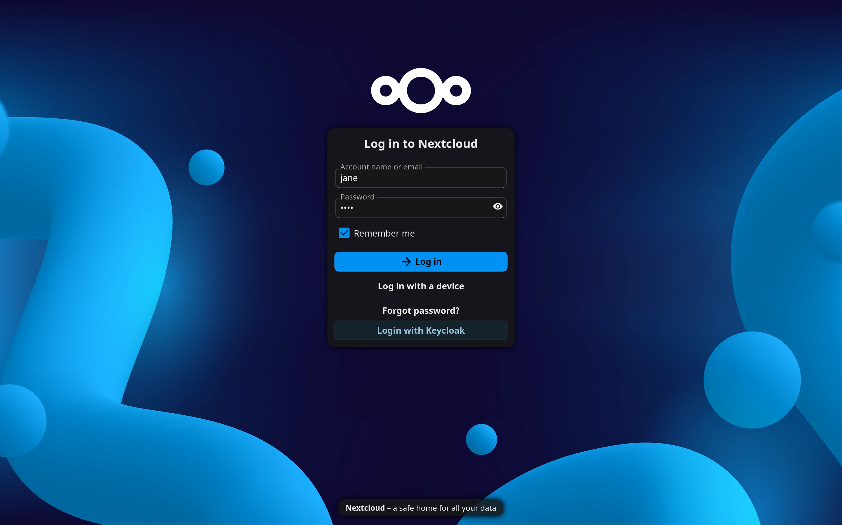
Notes:
Click on that and it will take us to our Nextcloud login page.
So now, if we login as Jane Doe, for example, …

Slide 23
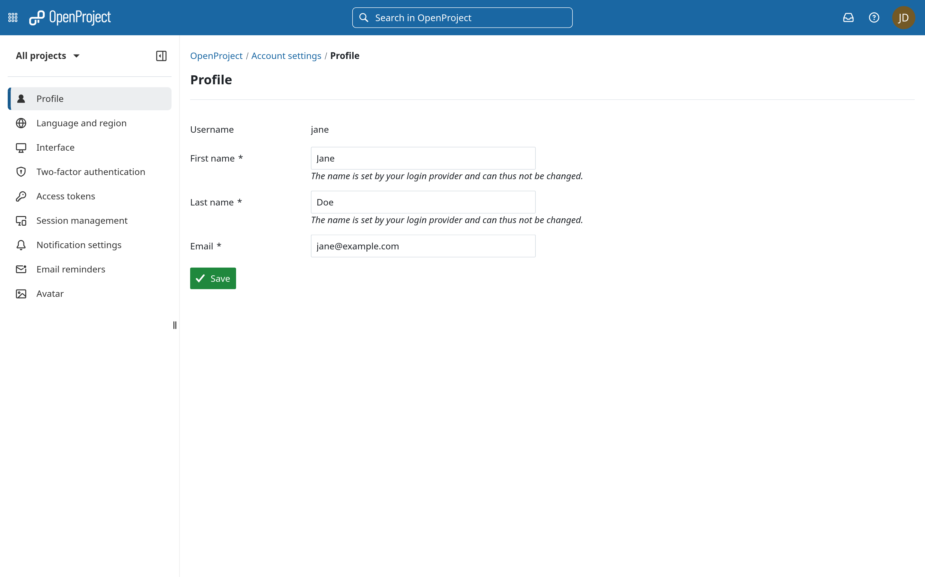
Notes:
… we will automatically be redirected back to OpenProject logged in as Jane Doe!
You can also see in their profile page that their first and last names are also prefilled in addition to the email address which was either taken from Nextcloud or automatically generated.
But regardless, we can see that these users actually work and can immediately get started using both OpenProject and Nextcloud in tandem with other.

Slide 24
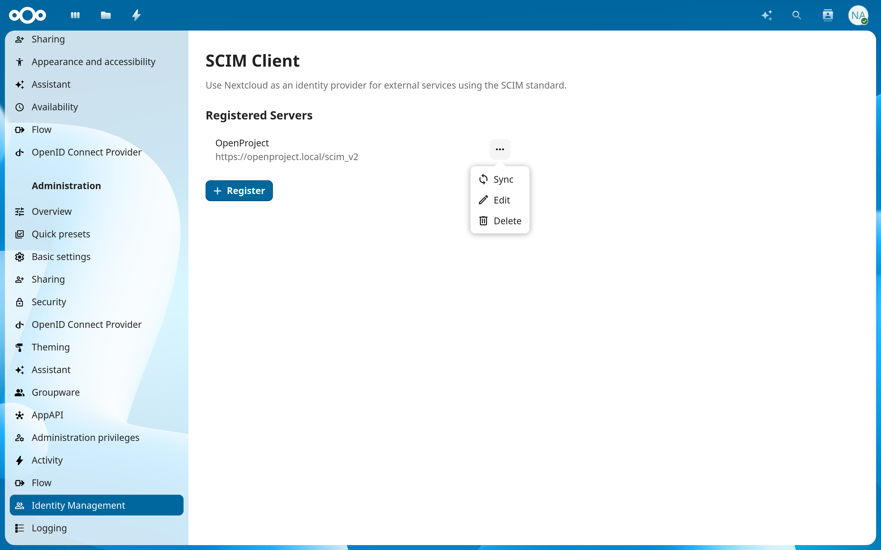
Notes:
That was pretty much the end of the demo, but I wanna go back to the administrator side really quickly because I do wanna touch on a few extra features that we’ve added to the app, mainly some things you can do to the servers you have already added.
First, in case anything goes wrong with the automatic updates, there is the option to invoke a full re-sync manually.
It basically does the same thing as the initial background job, but this option allows you to run that operation at any time instead of just once.
Next, you can edit the connection details, update the server name or change the bearer token, for example.
Say if you wanted to migrate from one OpenProject instance to another, you can keep using Nextcloud as the source of truth rather than the old OpenProject instance you want to migrate from.
Just change the domain name from the old server to the new server, update the access token, and you’re good to go!
And the last thing you can do is delete the server altogether.
If you ever wanted to pause the syncing operation for any particular server, for example, the best way to do that would be to just delete the server, and then register the server again at a later date.
That way, any changes that may have happened during the pause would be able to be applied to the server as well.

Slide 25

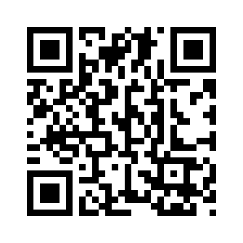
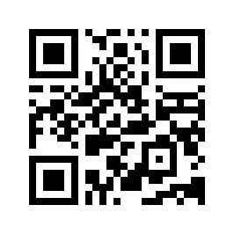
Thank you for your attention!
Notes:
So that is pretty much it.
I hope you found this talk insightful as I went over why we made this app, as well as what it can potentially accomplish.
If you’re interested in learning more, the left QR code will take you to the app store page for the SCIM client app where you can find all of the relevant details for the project including the source code.
And the right QR code will take you to our jobs page as we are looking to hire more developers and continue growing in 2026.
If you would like to contribute to the Nextcloud ecosystem, and get paid while doing it, we very much invite you to apply.
Also, as part of our commitment to diversity, equity, and inclusion, we are currently offering additional support and mentoring for anyone who identifies as part of an under-represented minority group.
This could include anything from gender to sexual orientation, ethnicity, physical or mental ability, neurodiversity, etc.
If you would like more details, I will be available to chat after this talk or at the Nextcloud booth in F1 where I can connect you to one of our mentors.
But, anyway, that is all I have for this presentation, thanks so much for listening.
I will now open up the floor for any questions.

